Slide 2
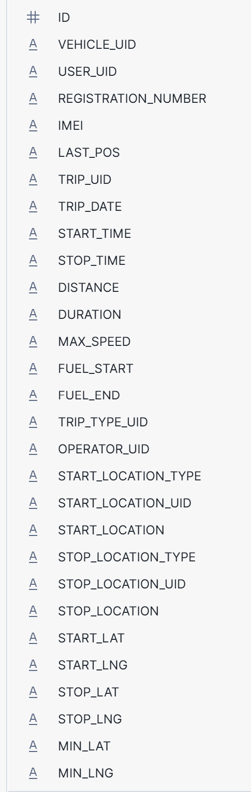
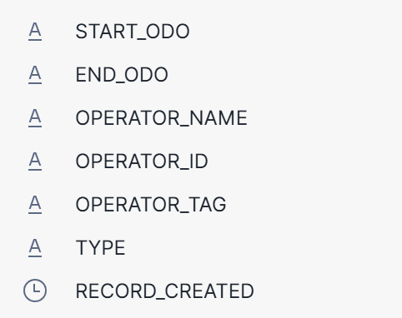

Slide 3
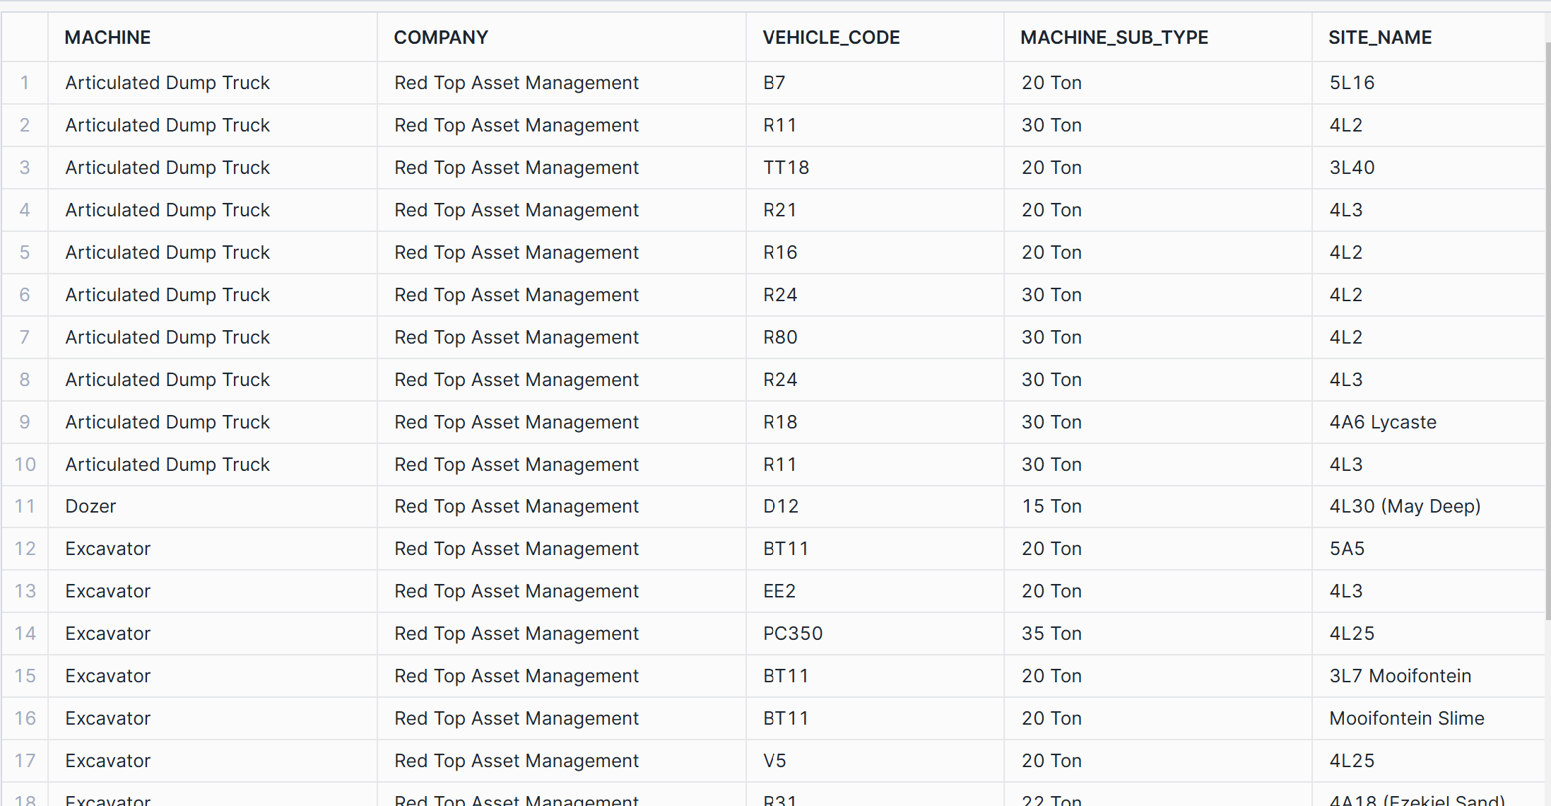

Slide 4
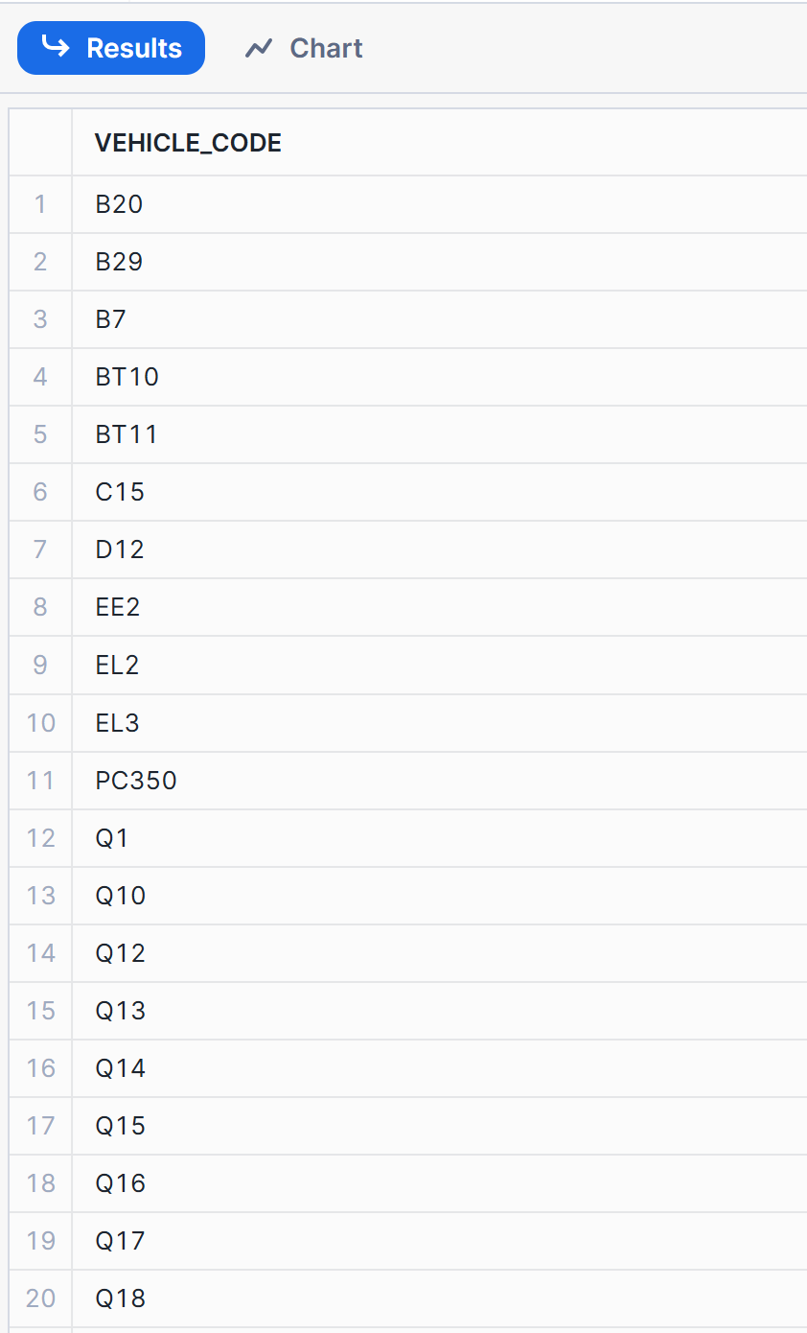
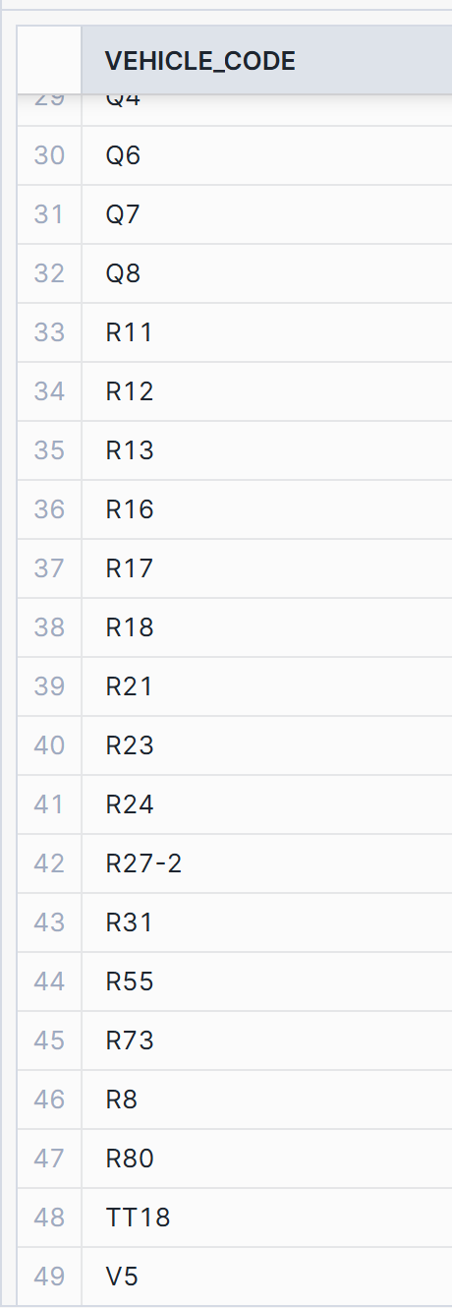

Slide 5
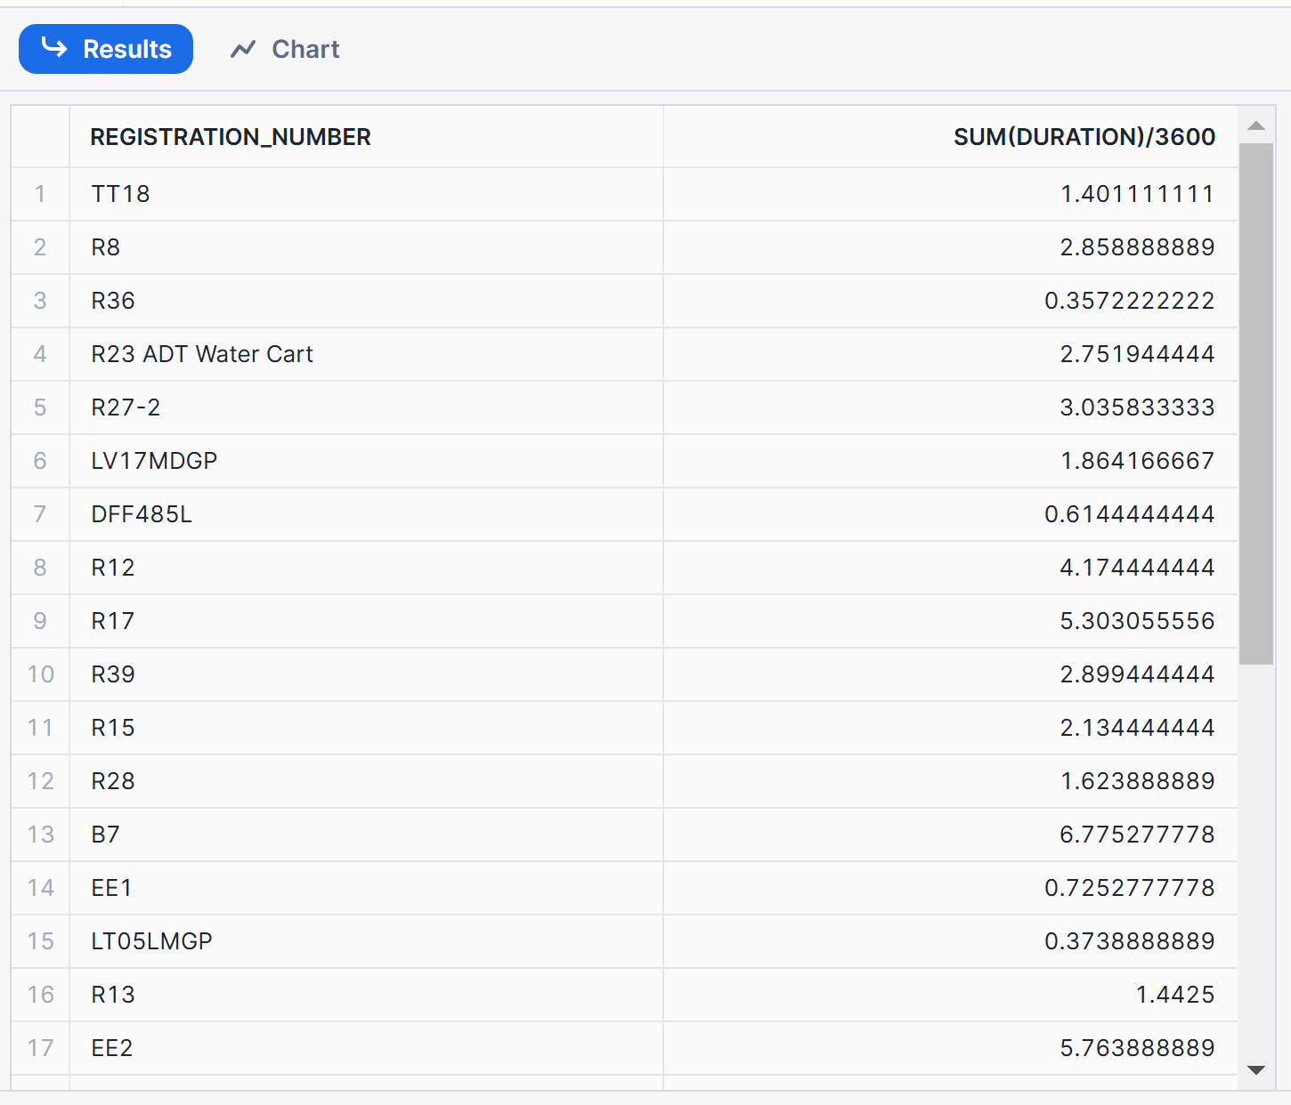

Slide 6
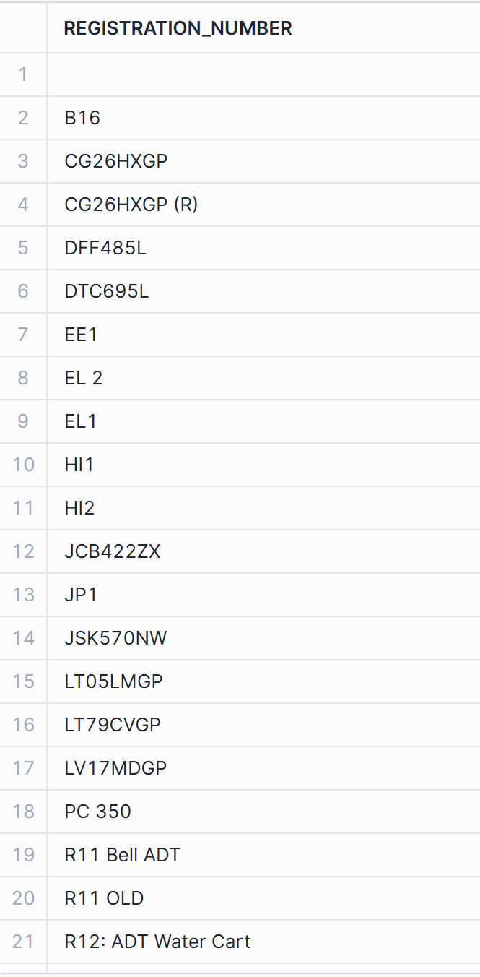
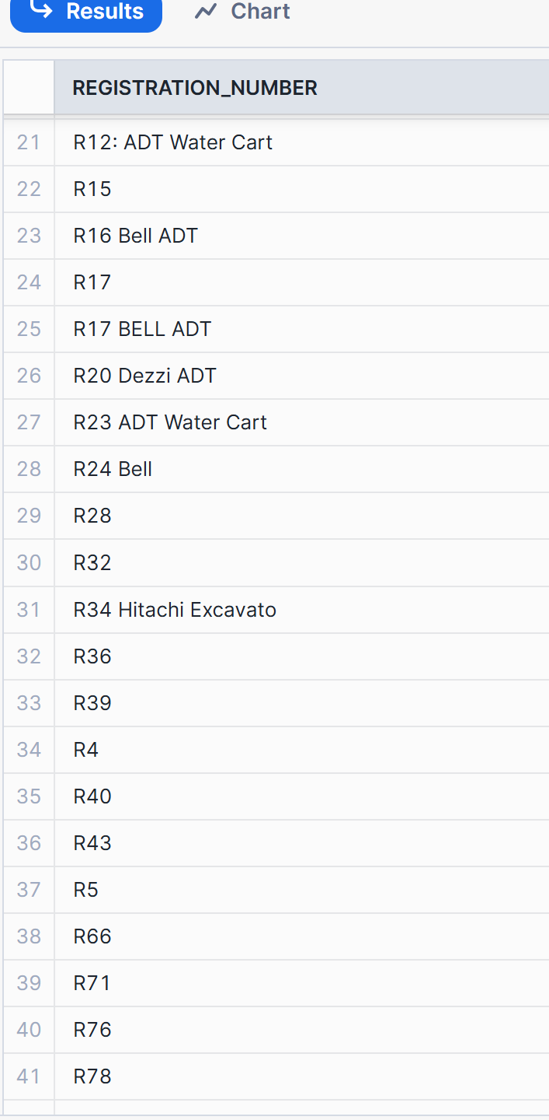

Slide 7
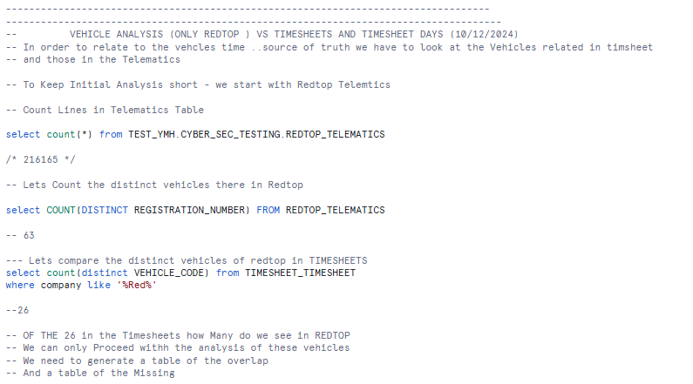
Exploratory Analysis of Redtop Vehicles and Timesheets (Related to sql – Initial exploratory analysis)
Initial analysis of vehicle Counts

Slide 8
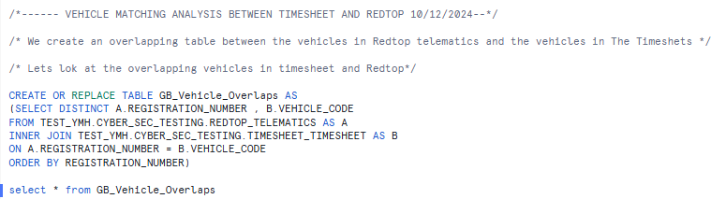
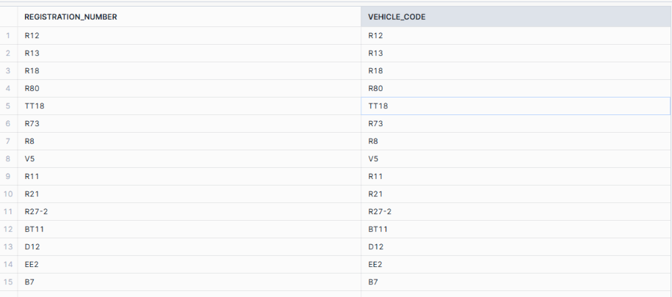
Code to Do the Overlaps And Table – Only 15 Vehicles can be found
Redtop
TIMESHEETS

Slide 9
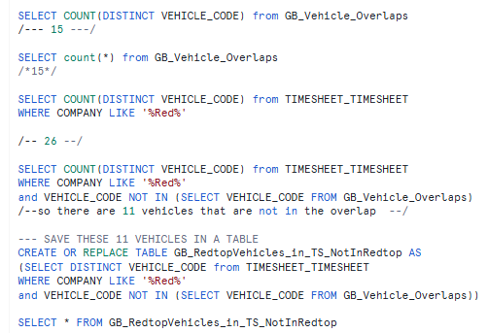
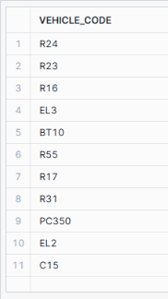
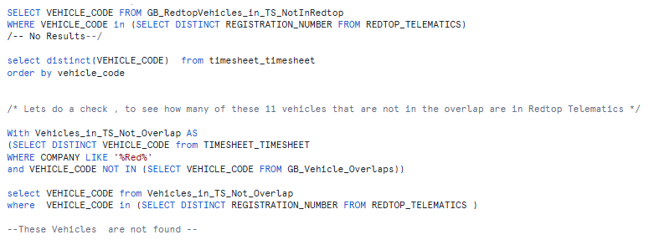
Further Analysis to get the discrepancies for the timesheet perspective
NEED TO GET THE MISSING VALUES HERE
IE THESE CODES MUST BE TRACKED TO REDTOP
SQL CHECKS AND BALANCES ON VEHICLES

Slide 10
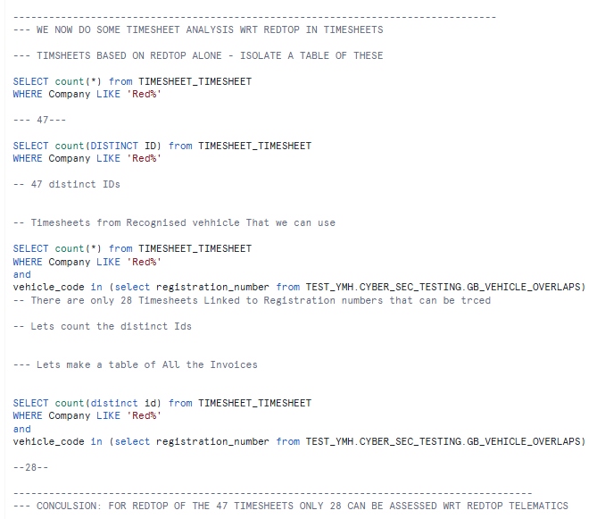
Timesheets Now Based on Redtop
Some Initial Checks (of 47 only 28 are trackable)
( We need to list these, Overleaf )

Slide 11
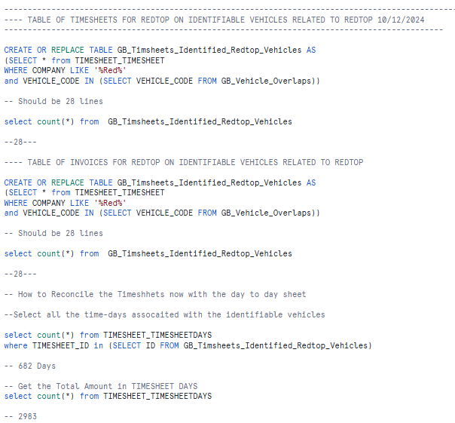
Retrieving the TS for the Identifiable Vehicles (Redtop and TS )

Slide 12
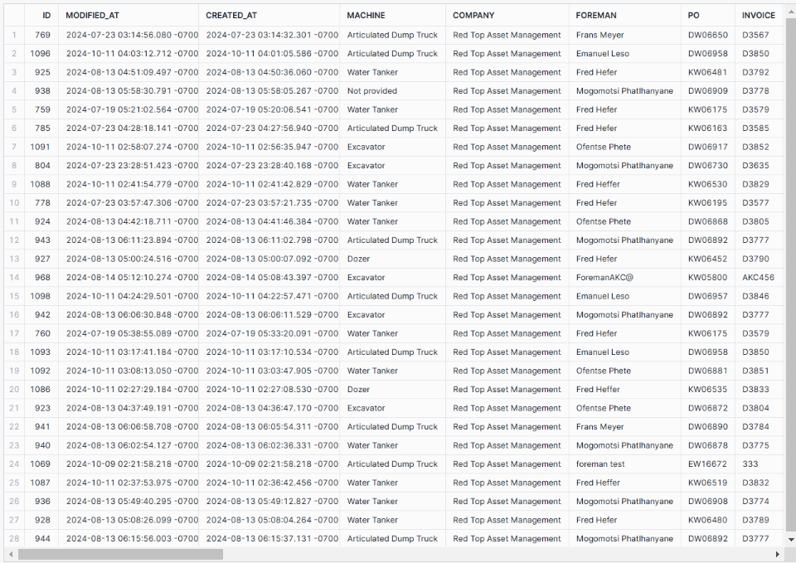
Table of the 28 Timesheets that we can find in the overlap

Slide 13
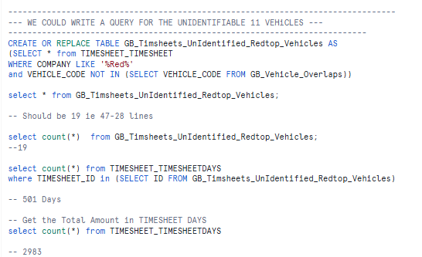
We now do the opposite , Make a table of other Invoices

Slide 14
The Actual Unidentifiable Invoices (Code)

Slide 15
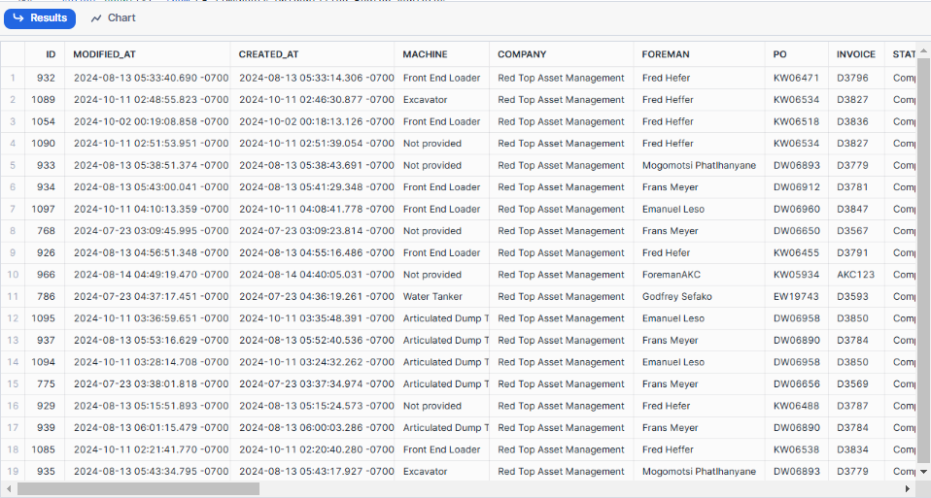
The Table Of Unidentified invoices

Slide 16
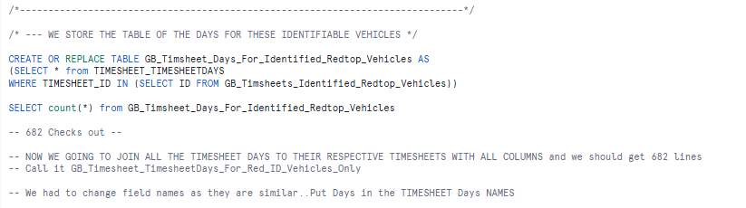
We now do the same thing for Timesheet days – Identied days

Slide 17
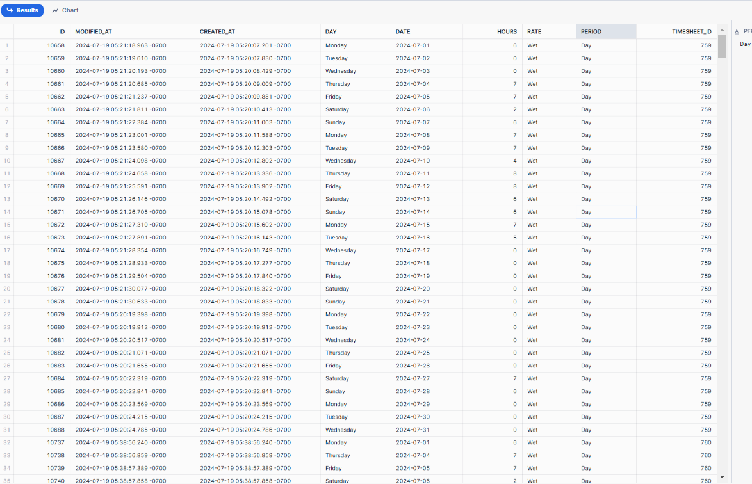
Timesheet has many lines so see each day of the invoice

Slide 18
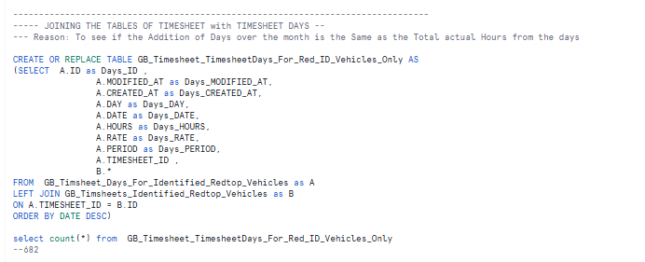
For The Sake of Reconciling we join these 2 tables – for the identifiable Redtop we check to see if the join makes sense ..we get 682 lines

Slide 19
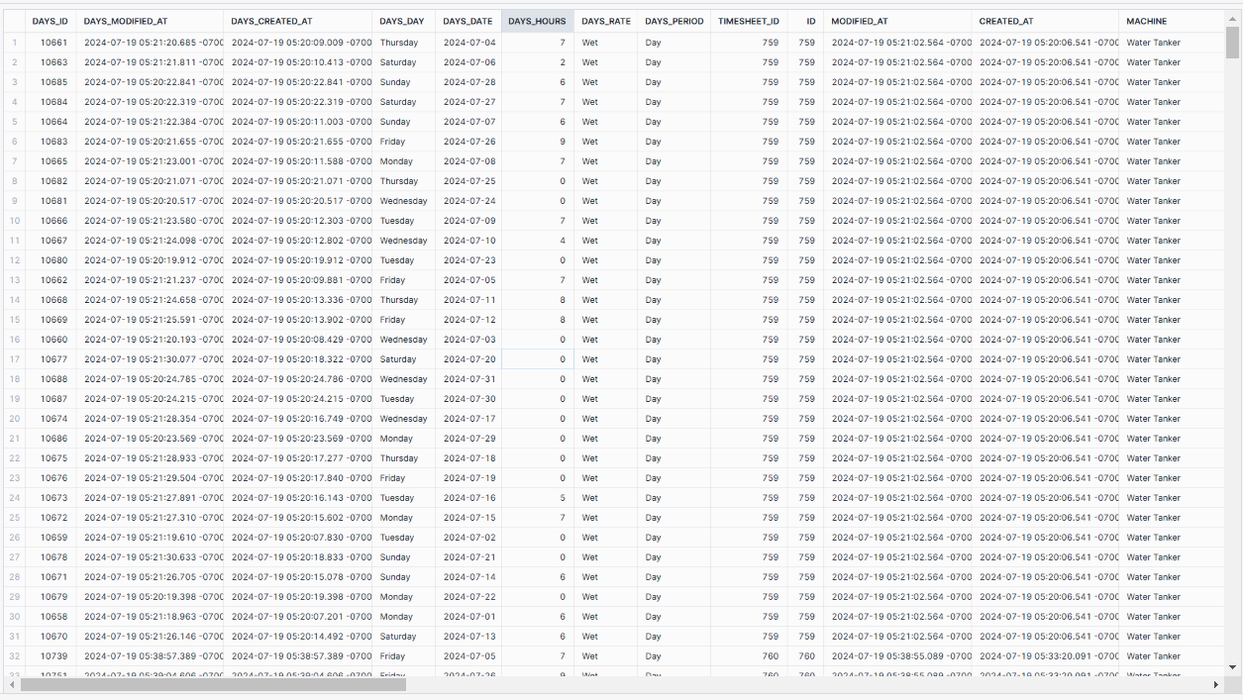
Sample of the Joined Table –Ts with Ts_Days – see TS repeated every day

Slide 20
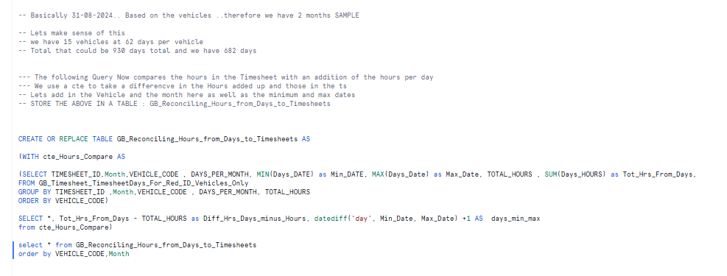
Query to Compare Hours on Ts Versus Days

Slide 21
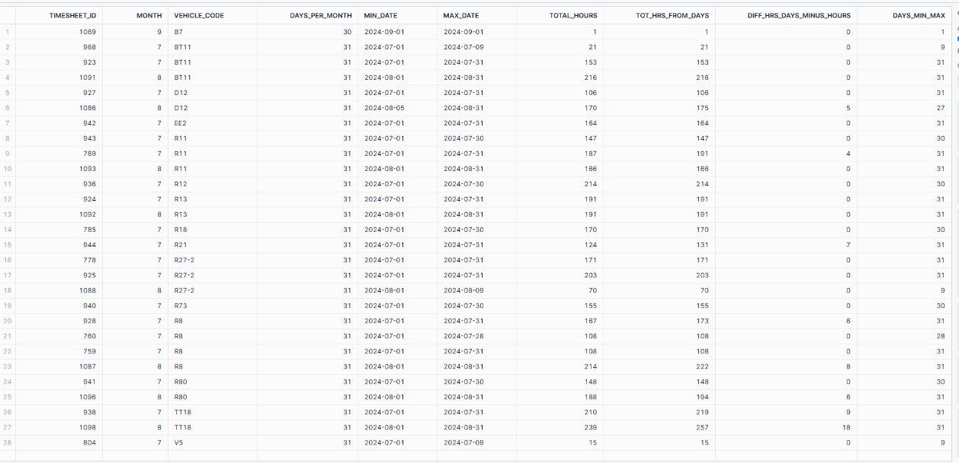
Table of Results for the Comparing Days to TS

Slide 22
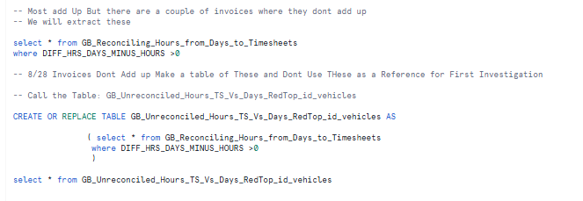
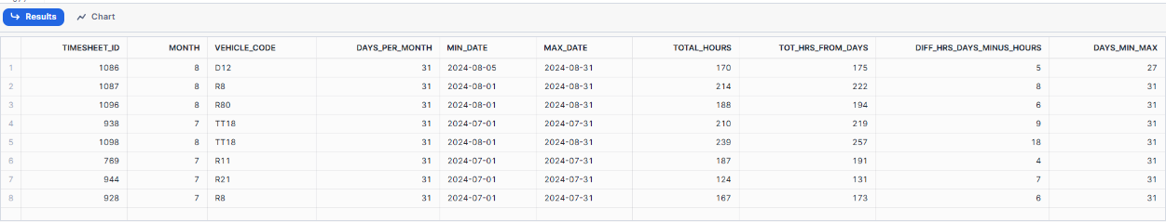
Compute the Unreconciled Invoices

Slide 23
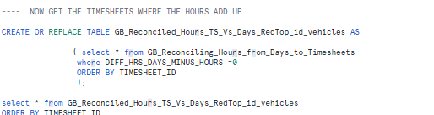
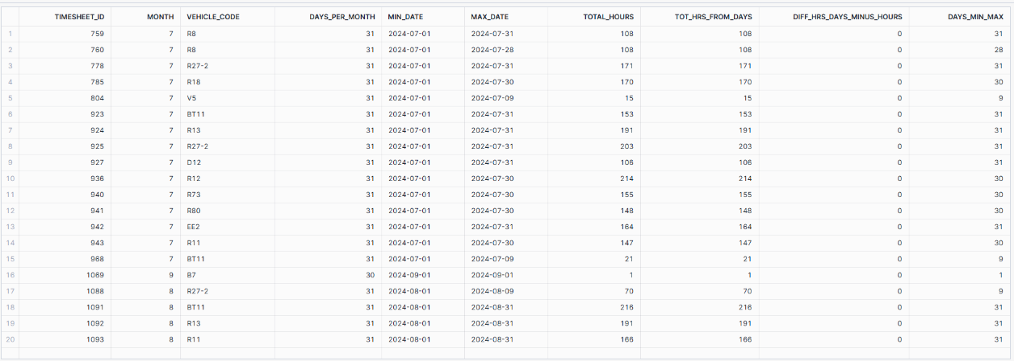
Now Get the Reconciled Invoices where differences are zxero

Slide 24
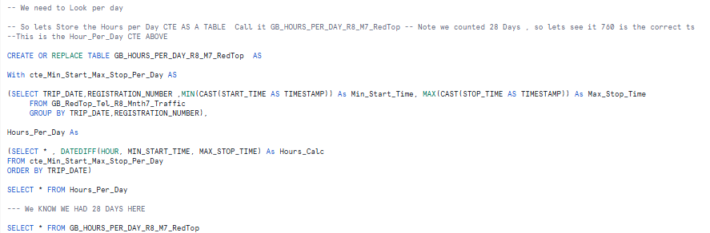
Query for Hours in Redtop For R8 Month 7 All Timesheets

Slide 25
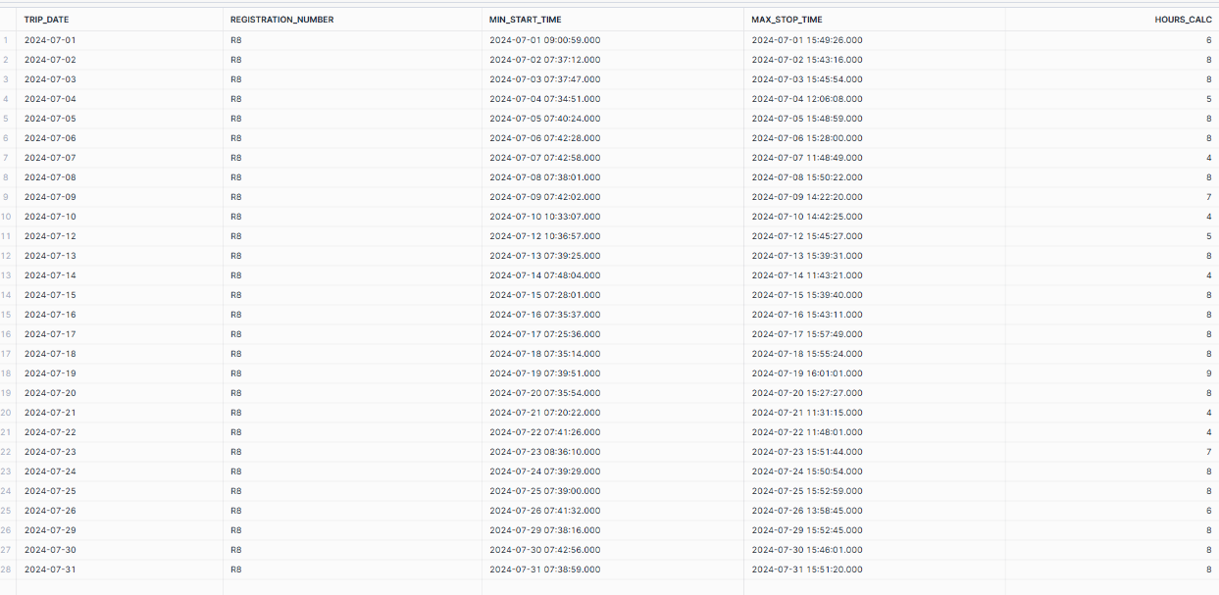
This was the Hours For R8 I RedTop

Slide 26
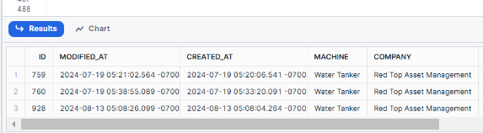
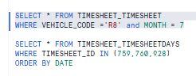
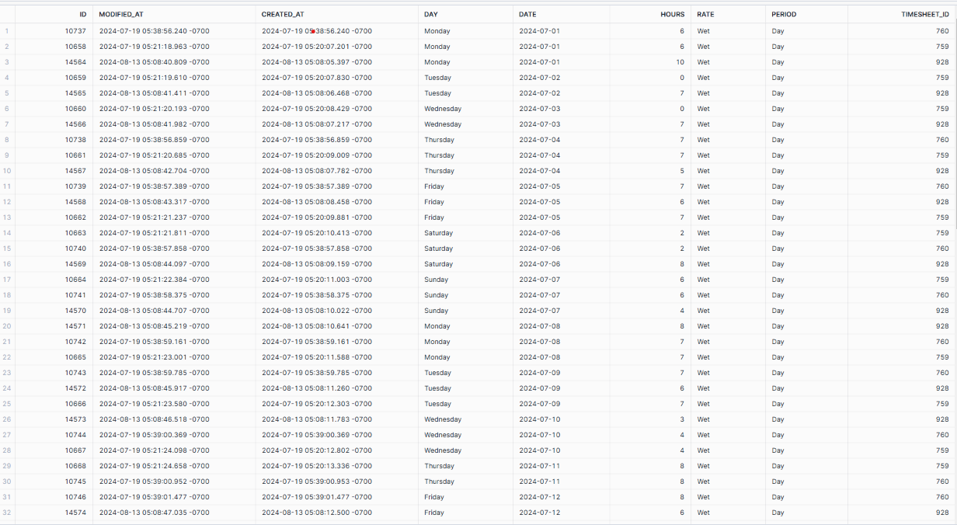
There are 3 Timesheets Associated with R8 in July (759,760,928) ,see next 3 pages

Slide 27
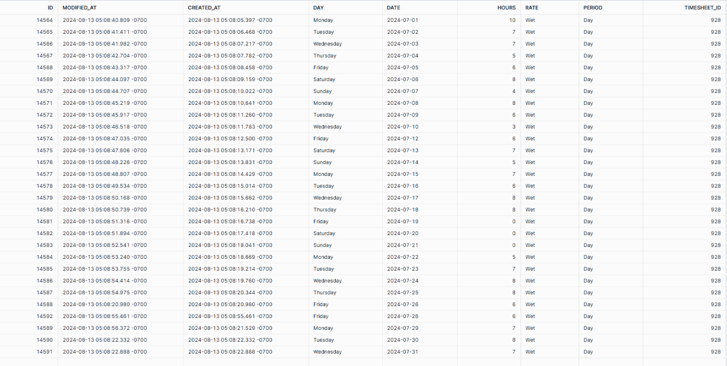
On Looking Closely ..Day By Day between the Total RedTop and the Timesheet Days for R8 , looking at each contract , on most days 928 comes very close , also the days line up More Exactly Except for 0 Readings An error anylaysis need to be done using a join 928 alone is shown below.. Lets jus

Slide 28
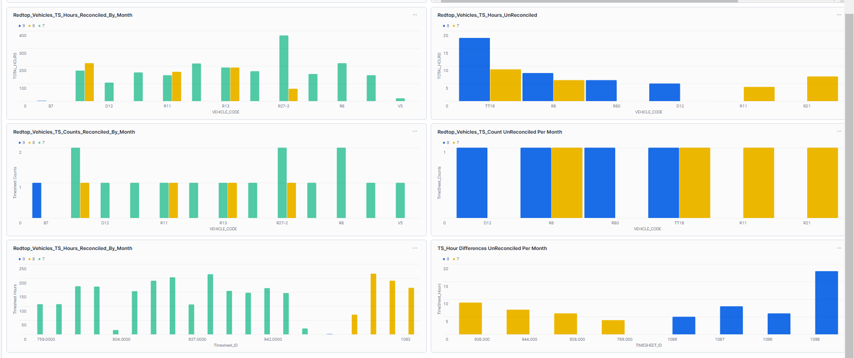
Redtop To Match Dashboard with Quartz

Slide 29
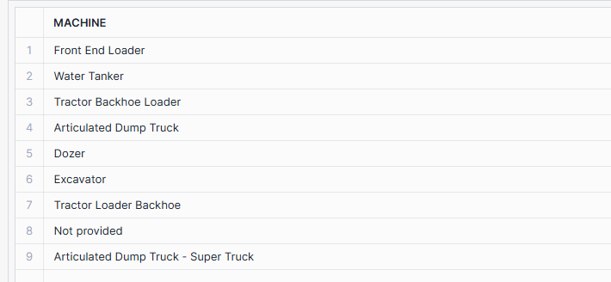
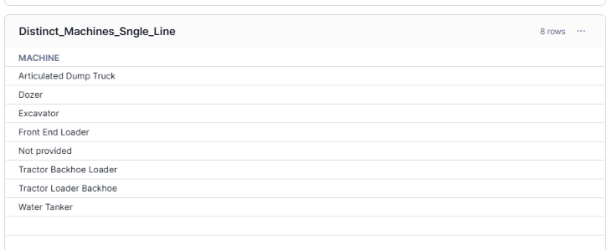
Strange Event
Prior to 20/1/2025
On 20/1/2025- See Extra –Articulated Dump Truck- Super Truck

Slide 30
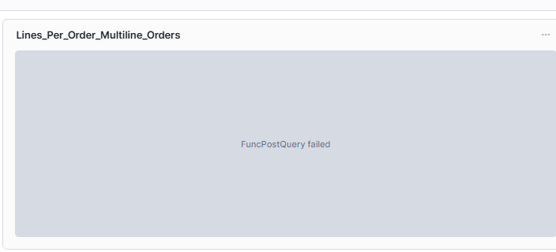
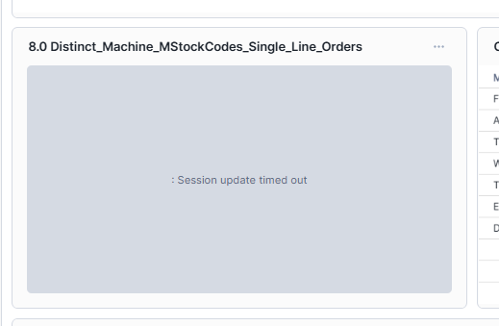
Investigate_por_Master_Detail

Slide 31
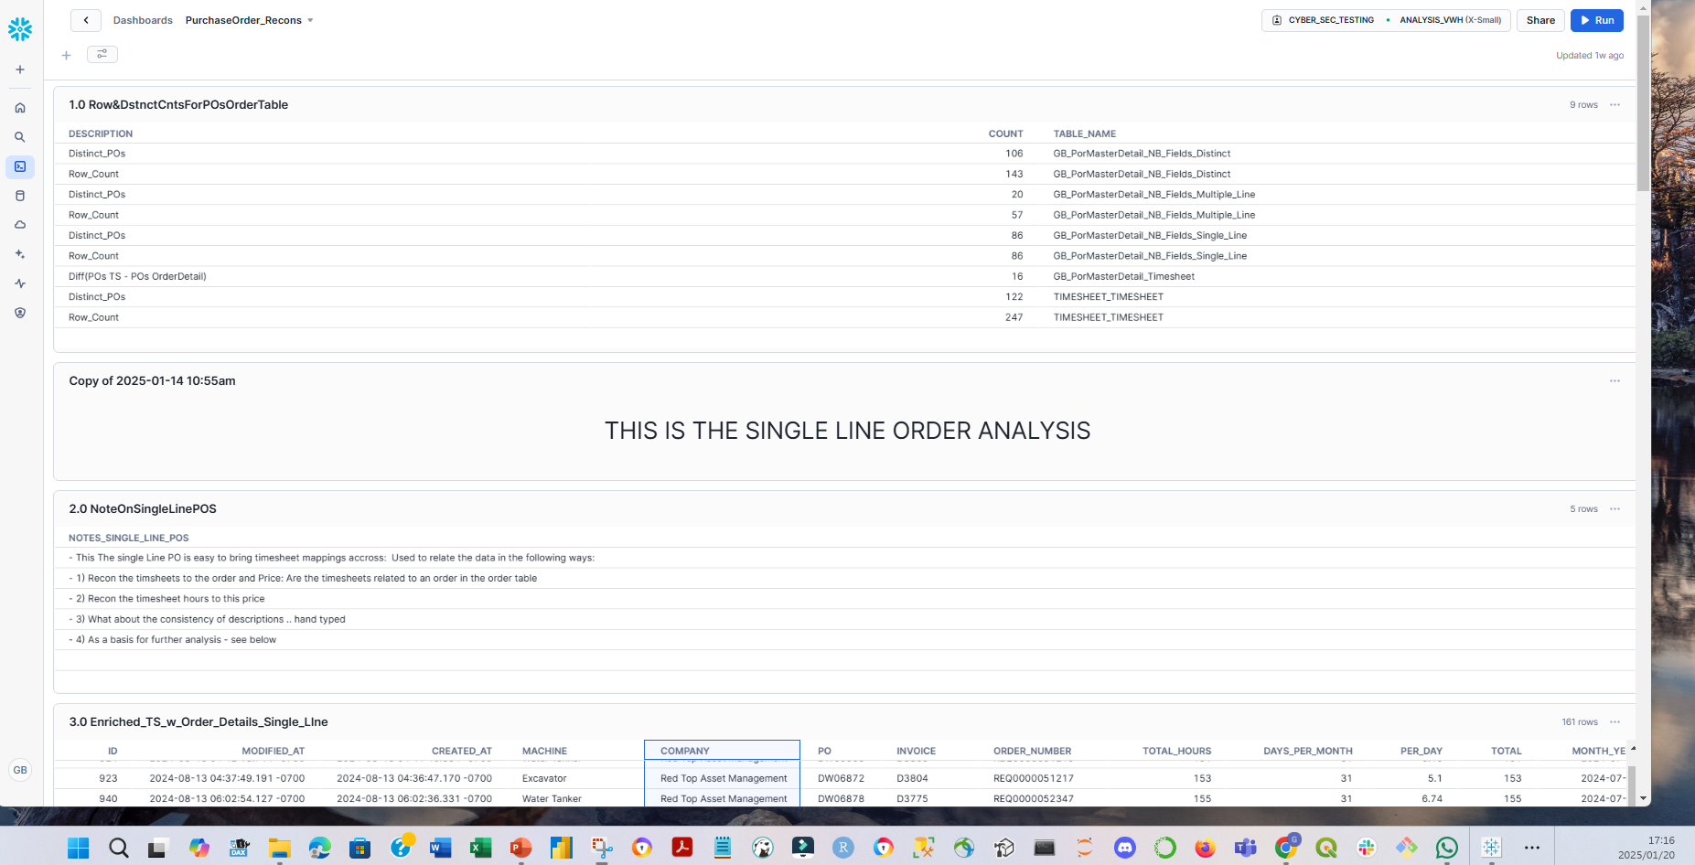
Latest DB – Having Session Update Timeouts- 5:10pm

Slide 32
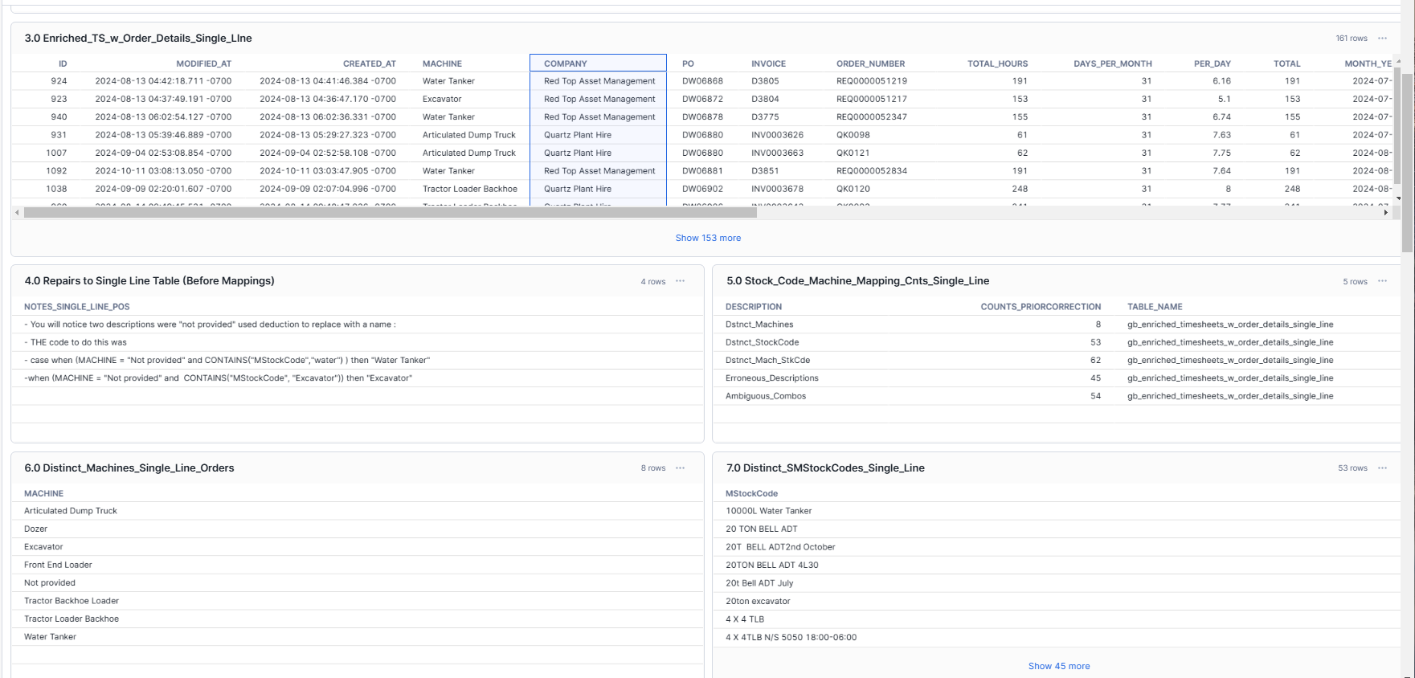
P2: Purchase Order Recons

Slide 33
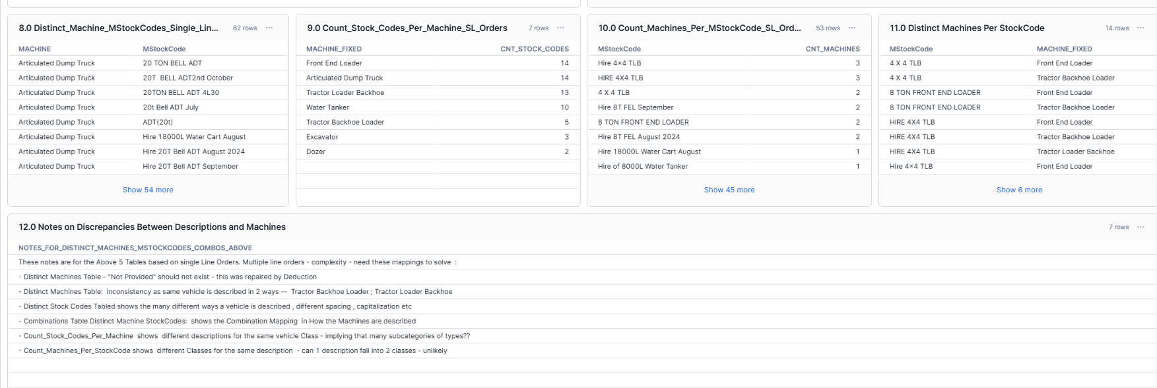
P3: Purchase Order Recons

Slide 34
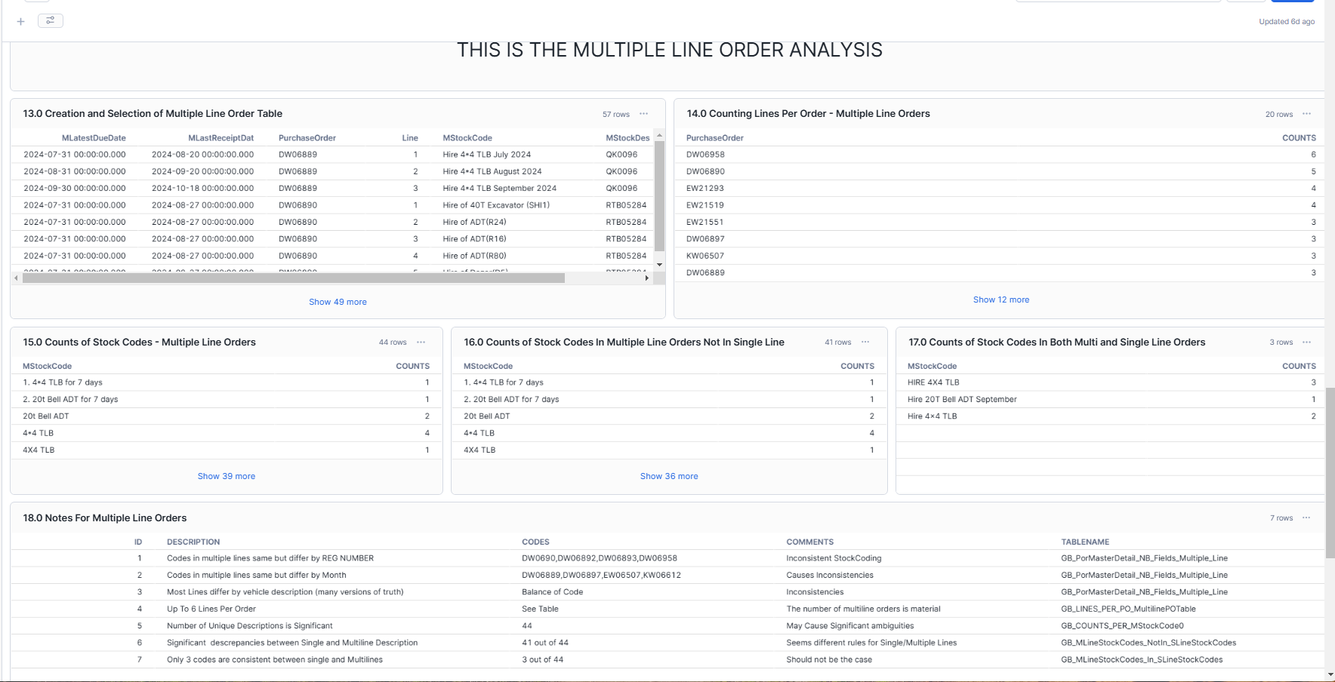
P4: Multiple Line Orders

Slide 35
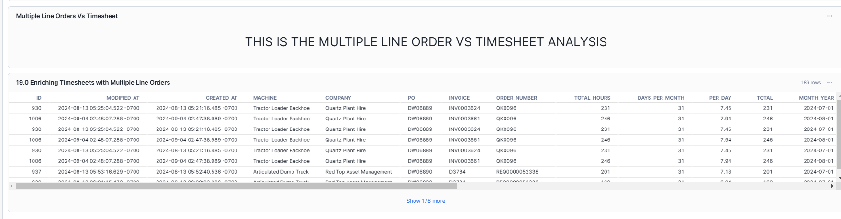
P5- Joining Multiple Line Orders , Ambiguity
V

Slide 36
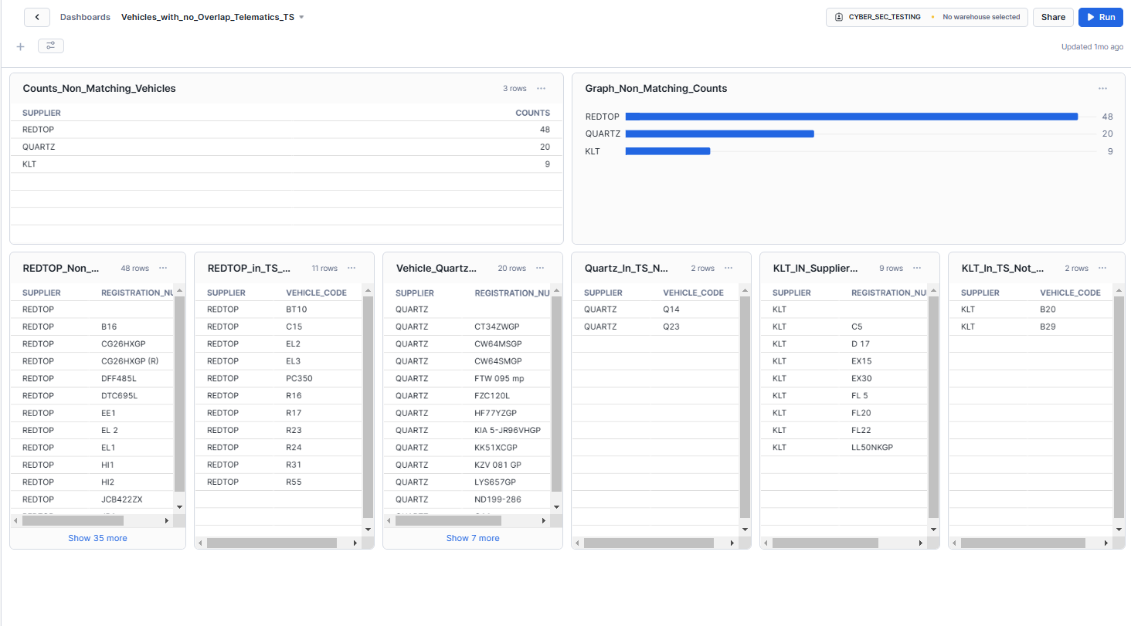
Vehicle- Non Overlapping – TS-Telematics

Slide 37
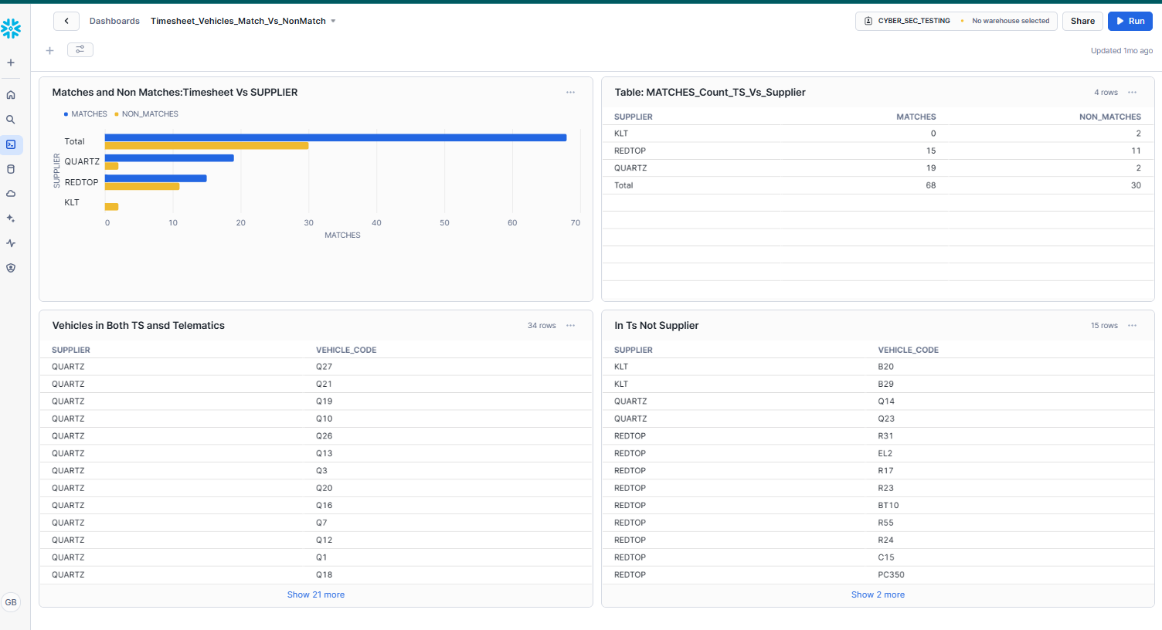
Timesheet_Vehicles_Match_Vs_NonMatch

Slide 38
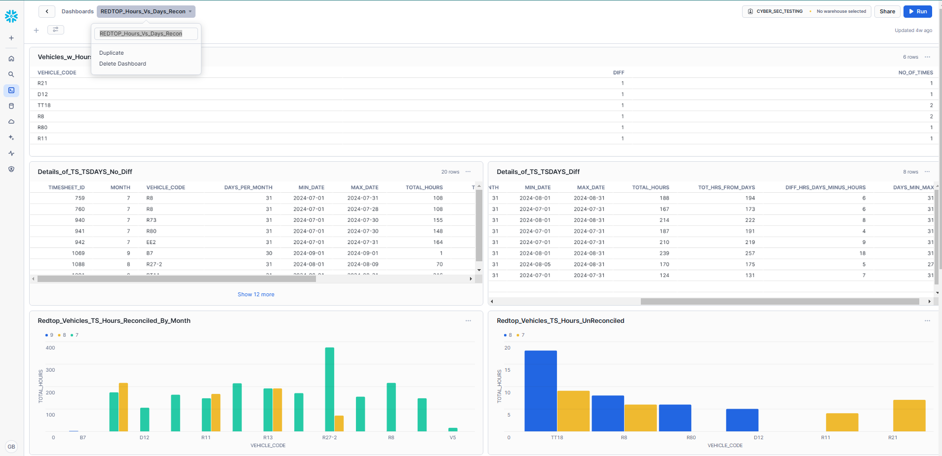
P1- REDTOP_Hours_Vs_Days_Recon

Slide 39
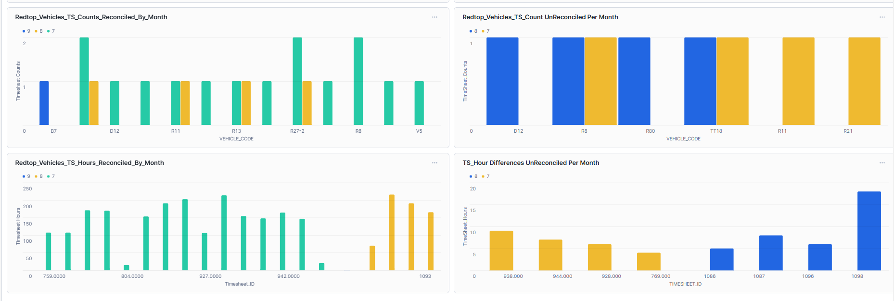
P2- REDTOP_Hours_Vs_Days_Recon

Slide 40
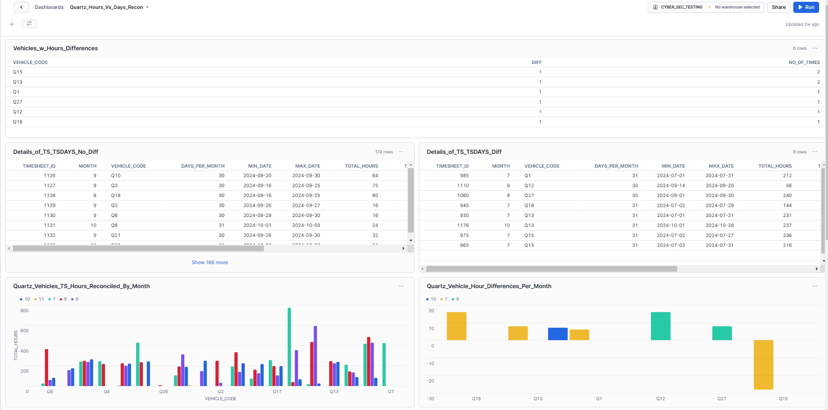
P1-Quartz_Hours_Vs_Days_Recon

Slide 41

P2-Quartz_Hours_Vs_Days_Recon

Slide 42








Tables Provided at a point in time

Slide 43

Snowflake Warnings

Slide 44


https://docs.snowflake.com/en/release-notes/bcr-bundles/2024_08/bcr-1801

Slide 45

WW79180

Slide 46
Images of Dashboards

Slide 47

1.0 PurchaseOrder_Recons (From 1.0 Purchase Order Recons) – Page 1

Slide 48

1.0 PurchaseOrder_Recons (From 1.0 Purchase Order Recons) – Page 2 –single Order Analysis continued

Slide 49

1.0 PurchaseOrder_Recons (From 1.0 Purchase Order Recons) – Page 3 –single Order Analysis continued

Slide 50

1.0 PurchaseOrder_Recons (From 1.0 Purchase Order Recons) – Page 4 –Multiple Order Analysis continued

Slide 51

1.0 PurchaseOrder_Recons (From 1.0 Purchase Order Recons) – Page 5 –Multiple Order Vs Timesheet

Slide 52
Tables and Graphs for : 1.0 PurchaseOrder_Recons (From 1.0 Purchase Order Recons)
See directory DRD for following Charts Code
1.0 Row&DstnctCntsForPOsOrderTable
Title, This is the Single Order Analysis
2.0 NoteOnSingleLinePOS
3.0 Enriched_TS_w_Order_Details_Single_Line
4.0 Repairs to Single Line Table (Before Mappings)
5.0 Stock_Code_Machine_Mapping_Cnts_Single_Line
6.0 Distinct_Machines_Single_Line_Orders
7.0 Distinct_SMStockCodes_Single_Line
8.0 Distinct_Machine_MStockCodes_Single_Line_Orders
9.0 Count_Stock_Codes_Per_Machine_SL_Orders
10.0 Count_Machines_Per_MStockCode_SL_Orders
11.0 Distinct Machines Per StockCode
12.0 Notes on Discrepancies Between Descriptions and Machines
Title_Multiple Order Analysis
13.0 Creation and Selection of Multiple Line Order Table
14.0 Counting Lines Per Order - Multiple Line Orders
15.0 Counts of Stock Codes - Multiple Line Orders
16.0 Counts of Stock Codes In Multiple Line Orders Not In Single Line
17.0 Counts of Stock Codes In Both Multi and Single Line Orders
18.0 Notes For Multiple Line Orders
19.0 Enriching Timesheets with Multiple Line Orders
A1.1 Special Multiple Line Order Investigation

Slide 53

2.0 Timesheet_Vehicles_Match_Vs_NonMatch

Slide 54

3.0 Analysis_of_IMEI_Vehicle_Mappings Part 1

Slide 55

3.0 Analysis_of_IMEI_Vehicle_Mappings Part 2

Slide 56

4.0 NonOverlapVehicles_Ts_Supplier(From 2.0 Timesheet_Vehicles_Match_Vs_NonMatch)

Slide 57

5.0 Recon Timesheets and Timesheet Days

Slide 58

6a REDTOP_Hours_Vs_Days_Recon – Part 1

Slide 59

6a REDTOP_Hours_Vs_Days_Recon – Part 2

Slide 60

6b. Quartz_Hours_Vs_Days_Recon Part 1

Slide 61

6b. Quartz_Hours_Vs_Days_Recon Part2

Slide 62

Stored_Procs

